Slide 1
Fundamentals of Python: First Programs Second Edition
Design with Classes

Slide 2
Objectives (1 of 2)
9.1 Determine the attributes and behavior of a class of objects required by a program
9.2 List the methods, including their parameters and return types, that realize the behavior of a class of objects
9.3 Choose the appropriate data structures to represent the attributes of a class of objects
9.4 Define a constructor, instance variables, and methods for a class of objects

Slide 3
Objectives (2 of 2)
9.5 Recognize the need for a class variable
9.6 Define a method that returns the string representation of an object
9.7 Define methods for object equality and comparisons
9.8 Exploit inheritance and polymorphism when developing classes
9.9 Transfer objects to and from files

Slide 4
Getting Inside Objects and Classes
Programmers who use objects and classes know:
The interface that can be used with a class
The state of an object
How to instantiate a class to obtain an object
Objects are abstractions
Package their state and methods in a single entity that can be referenced with a name
Class definition is like a blueprint for each of the objects of that class and contains:
Definitions of all of the methods that its objects recognize
Descriptions of the data structures used to maintain the state of an object

Slide 5
A First Example: The Student Class (1 of 3)
A course-management application needs to represent information about students in a course
>>> from student import Student
>>> s = Student(“Maria”, 5)
>>> print(s)
Name: Maria
Scores: 0 0 0 0 0
>>> s.setScore(1, 100)
>>> print(s)
Name: Maria
Scores: 100 0 0 0 0
>>> s.getHighScore()
100
>>> s.getAverage()
20
>>> s.getScore(1)
100
>>> s.getName()
'Maria'

Slide 6
A First Example: The Student Class (2 of 3)
Student Method | What It Does
s = Student(name, number) | Returns a Student object with the given name and number of scores. Each score is initially 0
s.getName() | Returns the student’s name
s.getScore(i) | Returns the student’s ith score, i must range from 1 through the number of scores
s.setScore(i, score) | Resets the student’s ith score to score, i must range from 1 through the number of scores
s.getAverage() | Returns the student’s average score
s.getHighScore() | Returns the student’s highest score
s.__str()__ | Same as str(s). Returns a string representation of the student’s information

Slide 7
A First Example: The Student Class (3 of 3)
Syntax of a simple class definition:
class <class name>(<parent class name>):
<method definition−1>
…
<method definition−n>
Class name is a Python identifier
Typically capitalized
Python classes are organized in a tree-like class hierarchy
At the top, or root, of this tree is the object class
Some terminology: subclass, parent class

Slide 8
Docstrings
Docstrings can appear at three levels:
Module
Just after class header
To describe its purpose
After each method header
Serve same role as they do for function definitions
help(Student) prints the documentation for the class and all of its methods

Slide 9
Method Definitions
Method definitions are indented below class header
Syntax of method definitions similar to functions
Can have required and/or default arguments, return values, create/use temporary variables
Returns None when no return statement is used
Each method definition must include a first parameter named self
Example: s.getScore(4)
Binds the parameter self in the method getScore to the Student object referenced by the variable s

Slide 10
The _init_ Method and Instance Variables
Most classes include the __init__ method
def __init__(self, name, number):
“““All scores are initially 0.”””
self.name = name
self.scores = []
for count in range(number):
self.scores.append(0)
Class’s constructor
Runs automatically when user instantiates the class
Example: s = Student(“Juan”, 5)
Instance variables represent object attributes
Serve as storage for object state
Scope is the entire class definition

Slide 11
The _str_ Method
Classes usually include an __str__ method
Builds and returns a string representation of an object’s state
def __str__(self) :
“““Returns the string representation of the student.”””
return "Name: " + self.name + “\nScores: ” + \
“ ”.join(map(str, self.scores))
When str function is called with an object, that object’s __str__ method is automatically invoked
Perhaps the most important use of __str__ is in debugging

Slide 12
Accessors and Mutators
Methods that allow a user to observe but not change the state of an object are called accessors
Methods that allow a user to modify an object’s state are called mutators
def setScore(self, i, score):
“““Resets the i th score, counting from 1.”””
self.scores[i − 1] = scor
Tip: if there’s no need to modify an attribute (e.g., a student’s name), do not include a method to do that

Slide 13
The Lifetime of Objects (1 of 2)
The lifetime of an object’s instance variables is the lifetime of that object
An object becomes a candidate for the graveyard when it can no longer be referenced
>>> s = Student(“Sam”, 10)
>>> cscilll = [s]
>>> cscilll
[<__main__.Student instance at 0xllba2b0>]
>>> s
<__main__.Student instance at 0xllba2b0>
>>> s = None
>>> cscilll.pop()
<__main__.Student instance at 0xllba2b0>
>>> print(s)
None
>>> cscilll
[]

Slide 14
The Lifetime of Objects (2 of 2)
From previous code, the student object still exists
But the Python virtual machine will eventually recycle its storage during a process called garbage collection

Slide 15
Rules of Thumb for Defining a Simple Class
Before writing a line of code, think about the behavior and attributes of the objects of new class
Choose an appropriate class name and develop a short list of the methods available to users
Write a short script that appears to use the new class in an appropriate way
Choose appropriate data structures for attributes
Fill in class template with __init__ and __str__
Complete and test remaining methods incrementally
Document your code

Slide 16
Data-Modeling Examples
As you have seen, objects and classes are useful for modeling objects in the real world
In this section, we explore several other examples

Slide 17
Rational Numbers
Rational number consists of two integer parts, a numerator and a denominator
Examples: 1/2, 2/3, etc.
Python has no built-in type for rational numbers
We will build a new class named Rational
>>> oneHalf = Rational(1, 2)
>>> oneSixth = Rational(1, 6)
>>> print(oneHalf)
1/2
>>> print(oneHalf + oneSixth)
2/3
>>> oneHalf == oneSixth
False
>>> oneHalf > oneSixth
True

Slide 18
Rational Number Arithmetic and Operator Overloading (1 of 3)
Operator | Method Name
+ | _add_
- | _sub_
* | _mul_
/ | _div_
% | _mod_
Object on which the method is called corresponds to the left operand
For example, the code x + y is actually shorthand for the code x.__add__(y)

Slide 19
Rational Number Arithmetic and Operator Overloading (2 of 3)
To overload an arithmetic operator, you define a new method using the appropriate method name
Code for each method applies a rule of rational number arithmetic
Type of Operation | Rule
Addition | n sub 1 over d sub 1, + n sub 2 over d sub 2 = left parenthesis, n sub 1 d sub 2 + n sub 2 d sub 1, right parenthesis, over d sub 1 d sub 2.
Subtraction | n sub 1 over d sub 1, minus n sub 2 over d sub 2 = left parenthesis, n sub 1 d sub 2 minus n sub 2 d sub 1, right parenthesis, over d sub 1 d sub 2.
Multiplication | n sub 1 over d sub 1, times, n sub 2 over d sub 2 = left parenthesis, n sub 1 d sub 2 times n sub 2 d sub 1, right parenthesis, over d sub 1 d sub 2.
Division | n sub 1 over d sub 1, over, n sub 2 over d sub 2 = left parenthesis, n sub 1 d sub d, right parenthesis, over, d sub 1 n sub 2.

Slide 20
Rational Number Arithmetic and Operator Overloading (3 of 3)
def __add__(self, other):
“““Returns the sum of the numbers.
self is the left operand and other is
the right operand.”””
newNumer = self.numer * other.denom + \
other.numer * self.denom
newDenom = self.denom * other.denom
return Rational(newNumer, newDenom)
Operator overloading is another example of an abstraction mechanism
We can use operators with single, standard meanings even though the underlying operations vary from data type to data type

Slide 21
Comparison Methods
Operator | Meaning | Method
== | Equals | _eq_
!= | Not equals | _ne_
< | Less than | _lt_
<= | Less than or equal | _le_
> | Greater than | _gt_
>= | Greater than or equal | _ge_

Slide 22
Equality and the _eq_ Method
Not all objects are comparable using < or >, but any two objects can be compared for == or !=
twoThirds < “hi there” should generate an error
twoThirds != “hi there” should return True
def __eq__(self, other):
“““Tests self and other for equality.”””
if self is other: # Object identity?
return True
elif type(self) != type(other): # Types match?
return False
else:
return self.numer == other.numer and \
self.denom == other.denom
Include __eq__ in any class where a comparison for equality uses a criterion other than object identity

Slide 23
Savings Accounts and Class Variables (1 of 4)
SavingsAccount Method | What It Does
a = SavingsAccount(name, pin, balance = 0.0) | Returns a new account with the given name, PIN, and balance
a.deposit(amount) | Deposits the given amount to the account’s balance
a.withdraw(amount) | Withdraws the given amount from the account’s balance
a.getBalance() | Returns the account’s balance
a.getName() | Returns the account’s name
a.getPin() | Returns the account’s PIN
a.computeInterest() | Computes the account’s interest and deposits it
a.__str__() | Same as str(a). Returns the string representation of the account

Slide 24
Savings Accounts and Class Variables (2 of 4)
Code for SavingsAccount:
“““
File: savingsaccount.py
This module defines the SavingsAccount class.
”””
class SavingsAccount(object):
“““This class represents a savings account
with the owner’s name, PIN, and balance.”””
RATE = 0.02 # Single rate for all accounts
def __init__(self, name, pin, balance = 0.0):
self.name = name
self.pin = pin
self.balance = balance
def __str__(self) :
“““Returns the string rep.”””
result = ‘Name: ’ + self.name + ‘\n’
result += ‘PIN: ’ + self.pin + ‘\n’
result += ‘Balance: ’ + str(self.balance)
return result

Slide 25
Savings Accounts and Class Variables (3 of 4)
Code for SavingsAccount (continued):
def getBalance(self):
“““Returns the current balance.”””
return self.balance
def getName(self):
“““Returns the current name.”””
return self.name
def getPin(self):
“““Returns the current pin.”””
return self.pin
def deposit(self, amount):
“““Deposits the given amount and returns None.”””
self.balance += amount
return None

Slide 26
Savings Accounts and Class Variables (4 of 4)
Code for SavingsAccount (continued):
def withdraw(self, amount):
“““Withdraws the given amount.
Returns None if successful, or an
error message if unsuccessful. ”””
if amount < 0:
return “Amount must be >= 0”
elif self.balance < amount:
return “Insufficient funds”
else:
self.balance -= amount
return None
def computeInterest(self):
“““Computes, deposits, and returns the interest.”””
interest = self.balance * SavingsAccount.RATE
self.deposit(interest)
return interest

Slide 27
Putting the Accounts into a Bank (1 of 3)
>>> from bank import Bank
>>> from savingsaccount import SavingsAccount
>>> bank = Bank()
>>> bank.add(SavingsAccount(“Wilma”, “1001”, 4000.00))
>>> bank.add(SavingsAccount(“Fred”, “1002”, 1000.00))
>>> print(bank)
Name: Fred
PIN: 1002
Balance: 1000.00
Name: Wilma
PIN: 1001
Balance: 4000.00
>>> account = bank.get(“Wilma”, “1000”)
>>> print(account)
None

Slide 28
Putting the Accounts into a Bank (2 of 3)
>>> account = bank.get(“Wilma”, “1001”)
>>> print (account)
Name: Wilma
PIN: 1001
Balance: 4000.00
>>> account.deposit(25.00)
>>> print(account)
Name: Wilma
PIN: 1001
Balance: 4025.00
>>> print(bank)
Name: Fred
PIN: 1002
Balance: 1000.00
Name: Wilma
PIN: 1001
Balance: 4025.00

Slide 29
Putting the Accounts into a Bank (3 of 3)
Bank Method | What It Does
b = Bank() | Returns a bank
b.add(account) | Adds the given account to the bank
b.remove(name, pin) | Removes the account with the given name and pin from the bank and returns the account. If the account is not in the bank, returns None
b.get(name, pin) | Returns the account associated with the name and pin if it’s in the bank. Otherwise, returns None
b.computelnterest() | Computes the interest on each account, deposits it in that account, and returns the total interest
b.__str__() | Same as str(b). Returns a string representation of the bank (all the accounts)

Slide 30
Using pickle for Permanent Storage of Objects
pickle allows programmer to save and load objects using a process called pickling
Python takes care of all of the conversion details
import pickle
def save(self, fileName = None):
“““Saves pickled accounts to a file. The parameter
allows the user to change filenames.”””
if fileName != None:
self.fileName = fileName
elif self.fileName == None:
return
fileObj = open(self. fileName, “wb”)
for account in self.accounts.values():
pickle.dump(account, fileObj)
fileObj.close()

Slide 31
Input of Objects and the try-except Statement
try:
<statements>
except <exception type>:
<statements>
def __init__(self, fileName = None):
“““Creates a new dictionary to hold the accounts.
If a filename is provided, loads the accounts from
a file of pickled accounts.”””
self.accounts = {}
self.fileName = fileName
if fileName != None:
fileObj = open(fileName, “rb”)
while True:
try:
account = pickle.load(fileObj)
self.add(account)
except EOFError:
fileObj.close()
break

Slide 32
Playing Cards (1 of 4)
Use of the Card class:
>>> threeOfSpades = Card(3, "Spades")
>>> jackOfSpades = Card(11, "Spades")
>>> print(jackOfSpades)
Jack of Spades
>>> threeOfSpades.rank < jackOfSpades.rank
True
>>> print(jackOfSpades.rank, jackOfSpades.suit)
11 Spades
Because the attributes are only accessed and never modified, we do not include any methods other than __str__ for string representation
A card is little more than a container of two data values

Slide 33
Playing Cards (2 of 4)
class Card(object):
“““A card object with a suit and rank.”””
RANKS = (1, 2, 3, 4, 5, 6, 7, 8, 9, 10, 11, 12, 13)
SUITS = (“Spades”, “Diamonds”, “Hearts”, “Clubs”)
def __init__(self, rank, suit):
“““Creates a card with the given rank and suit. ”””
self.rank = rank
self.suit = suit
def __str__(self) :
“““Returns the string representation of a card. ”””
if self.rank == 1:
rank = “Ace”
elif self.rank == 11:
rank = “Jack”
elif self.rank == 12:
rank = “Queen”
elif self.rank == 13:
rank = “King”
else:
rank = self.rank
return str(rank) + “of ” + self.suit

Slide 34
Playing Cards (3 of 4)
Unlike an individual card, a deck has significant behavior that can be specified in an interface
One can shuffle the deck, deal a card, and determine the number of cards left in it
>>> deck = Deck()
>>> print(deck)
--- the print reps of 52 cards, in order of suit and rank
>>> deck.shuffle()
>>> len(deck)
52
>>> while len(deck) > 0:
card = deck.deal()
print(card)
--- the print reps of 52 randomly ordered cards
>>> len(deck)
0

Slide 35
Playing Cards (4 of 4)
Deck Method | What It Does
d = Deck() | Returns a deck
d.__len__() | Same as len(d). Returns the number of cards currently in the deck
d.shuffle() | Shuffles the cards in the deck
d.deal() | If the deck is not empty, removes and returns the topmost card. Otherwise, returns None
d.__str__() | Same as str(d). Returns a string representation of the deck (all the cards in it)

Slide 36
Building a New Data Structure: The Two-Dimensional Grid
A useful data structure: two-dimensional grid
A grid organizes items by position in rows and columns
In this section, we develop a new class called Grid
For applications that require grids

Slide 37
The Interface of the Grid Class (1 of 2)
The constructor or operation to create a grid allows you to specify the width, the height, and an optional initial fill value for all of the positions
Default fill value is None
You access or replace an item at a given position by specifying the row and column of that position, using the notation:
grid[<row>] [<column>]

Slide 38
The Interface of the Grid Class (2 of 2)
Grid Method | What It Does
g = Grid(rows, columns, fillValue = None) | Returns a new Grid object
g.getHeight() | Returns the number of rows
g.getWidth() | Returns the number of columns
g.__str__() | Same as str(g). Returns the string representation
g.__getitem__(row)[column] | Same as g.[row][column]
g.find(value) | Returns (row, column) if value is found, or None otherwise

Slide 39
The Implementation of the Grid Class: Instance Variables for the Data
Implementation of a class provides the code for the methods in its interface
As well as the instance variables needed to track the data contained in objects of that class
Next step is to choose the data structures that will represent the two-dimensional structure within a Grid object
A single instance variable named self.data holds the top-level list of rows
Each item within this list will be a list of the columns in that row
Other two methods:
_init_, which initializes the instance variables
_str_, which allows you to view the data during testing

Slide 40
The Implementation of the Grid Class: Subscript and Search
Subscript operator
used to access an item at a grid position or to replace it there
In the case of access
The subscript appears within an expression, as in grid[1] [2]
Search operation named find must loop through the grid’s list of lists
Until it finds the target item or runs out of items to examine

Slide 41
Structuring Classes with Inheritance and Polymorphism
Most object-oriented languages require the programmer to master the following techniques:
Data encapsulation: Restricting manipulation of an object’s state by external users to a set of method calls
Inheritance: Allowing a class to automatically reuse/ and extend code of similar but more general classes
Polymorphism: Allowing several different classes to use the same general method names
Python’s syntax doesn’t enforce data encapsulation
Inheritance and polymorphism are built into Python

Slide 42
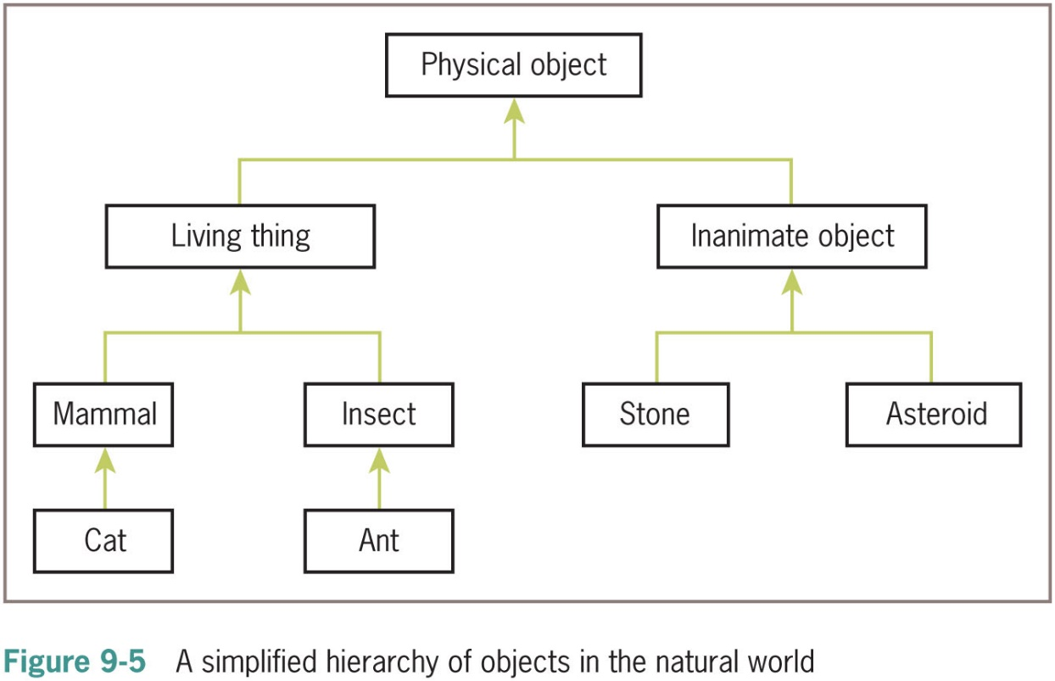
Inheritance Hierarchies and Modeling (1 of 2)

Slide 43
Inheritance Hierarchies and Modeling (2 of 2)
In Python, all classes automatically extend the built-in object class
It is possible to extend any existing class:
class <new class name>(<existing parent class name>):
Example:
PhysicalObject would extend object
LivingThing would extend PhysicalObject
Inheritance hierarchies provide an abstraction mechanism that allows the programmer to avoid reinventing the wheel or writing redundant code

Slide 44
Example 1: A Restricted Savings Account
>>> account = RestrictedSavingsAccount(“Ken”, “1001”, 500.00)
>>> print(account)
Name: Ken
PIN: 1001
Balance: 500.0
>>> account.getBalance()
500.0
>>> for count in range(3):
account.withdraw(100)
>>> account.withdraw(50)
‘No more withdrawals this month’
>>> account.resetCounter()
>>> account.withdraw(50)
To call a method in the parent class from within a method with the same name in a subclass:
<parent class name>.<method name>(self, <other arguments>)

Slide 45
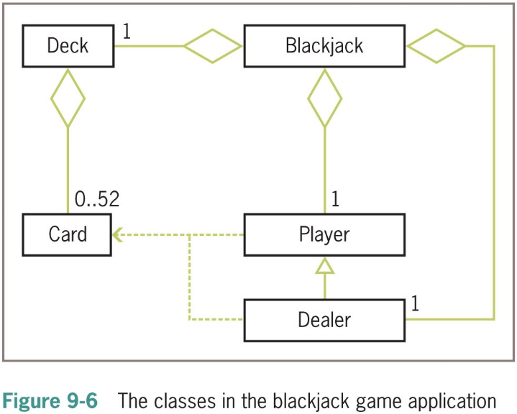
Example 2: The Dealer and a Player in the Game of Blackjack (1 of 2)

Slide 46
Example 2: The Dealer and a Player in the Game of Blackjack (2 of 2)
An object belonging to Blackjack class sets up the game and manages the interactions with user
>>> from blackjack import Blackjack
>>> game = Blackjack()
>>> game.play()
Player:
2 of Spades, 5 of Spades
7 points Dealer:
5 of Hearts
Do you want a hit? [y/n]: y
Player:
2 of Spades, 5 of Spades, King of Hearts
17 points
Do you want a hit? [y/n]: n
Dealer:
5 of Hearts, Queen of Hearts, 7 of Diamonds
22 points
Dealer busts and you win

Slide 47
Polymorphic Methods
We subclass when two classes share a substantial amount of abstract behavior
The classes have similar sets of methods/operations
A subclass usually adds something extra
The two classes may have the same interface
One or more methods in subclass override the definitions of the same methods in the superclass to provide specialized versions of the abstract behavior
Polymorphic methods (e.g., the __str__ method)

Slide 48
The Costs and Benefits of Object-Oriented Programming (1 of 2)
Imperative programming
Code consists of I/O, assignment, and control (selection/iteration) statements
Does not scale well
Improvement: Embedding sequences of imperative code in function definitions or subprograms
Procedural programming
Functional programming views a program as a set of cooperating functions
No assignment statements

Slide 49
The Costs and Benefits of Object-Oriented Programming (2 of 2)
Functional programming does not conveniently model situations where data must change state
Object-oriented programming attempts to control the complexity of a program while still modeling data that change their state
Divides up data into units called objects
Well-designed objects decrease likelihood that system will break when changes are made within a component
Can be overused and abused

Slide 50
Chapter Summary (1 of 2)
A simple class definition consists of a header and a set of method definitions
In addition to methods, a class can also include instance variables
Constructor or __init__ method is called when a class is instantiated
A method contains a header and a body
An instance variable is introduced and referenced like any other variable, but is always prefixed with self
Some standard operators can be overloaded for use with new classes of objects
When a program can no longer reference an object, it is considered dead and its storage is recycled by the garbage collector

Slide 51
Chapter Summary (2 of 2)
A class variable is a name for a value that all instances of a class share in common
Pickling is the process of converting an object to a form that can be saved to permanent file storage
try-except statement is used to catch and handle exceptions
Most important features of OO programming: encapsulation, inheritance, and polymorphism
Encapsulation restricts access to an object’s data to users of the methods of its class
Inheritance allows one class to pick up the attributes and behavior of another class for free
Polymorphism allows methods in several different classes to have the same headers
A data model is a set of classes that are responsible for managing the data of a program

